Slide 1
Lecture 12
pycuda

Slide 2
Cuda toolkit

Slide 3
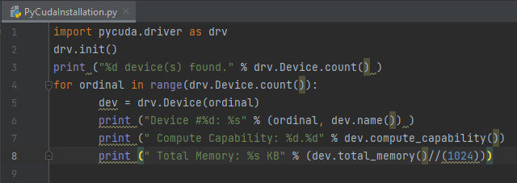
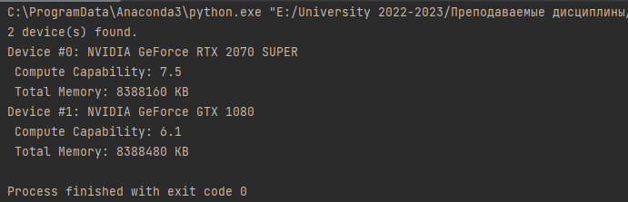
Verifying gpu

Slide 4
Verifying gpu
The execution is pretty simple. In the first line of code, pycuda.driver is imported and then initialized:
import pycuda.driver as drv
drv.init()
The pycuda.driver module exposes the driver level to the programming interface of CUDA, which is more flexible than the CUDA C "runtime-level" programming interface, and it has a few features that are not present at runtime.
Then, it cycles into drv.Device.count(), and for each GPU card found, the name of the cards and main characteristics (computing capability and total memory) are printed:
print ("Device #%d: %s" % (ordinal, dev.name()))
print ("Compute Capability: %d.%d" % dev.compute_capability())
print (" Total Memory: %s KB" % (dev.total_memory()//(1024)))

Slide 5
pycuda
The PyCUDA programming model is designed for the common execution of a program on a CPU and GPU, so as to allow you to perform the sequential parts on the CPU and the numeric parts, which are more intensive on the GPU. The phases to be performed in the sequential mode are implemented and executed on the CPU (host), while the steps to be performed in parallel are implemented and executed on the GPU (device). The functions to be performed in parallel on the device are called kernels. The steps to execute a generic function kernel on the device are as follows:
1. The first step is to allocate the memory on the device.
2. Then we need to transfer data from the host memory to that allocated on the device.
3. Next, we need to run the device:
  1. Run the configuration.
  2. Invoke the kernel function.
4. Then, we need to transfer the results from the memory on the device to the host memory.
5. Finally, release the memory allocated on the device.

Slide 6
Matrix multiplication
To show the PyCUDA workflow, let's consider a 5×5 random array and the following procedure:
1. Create the 5×5 array on the CPU.
2. Transfer the array to the GPU.
3. Perform a task on the array in the GPU (double all the items in the array).
4. Transfer the array from the GPU to the CPU.
5. Print the results.

Slide 7
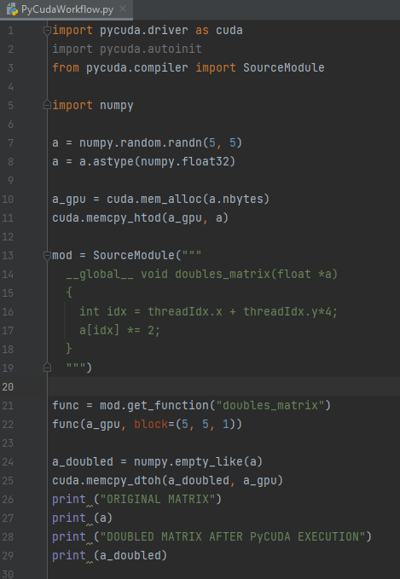
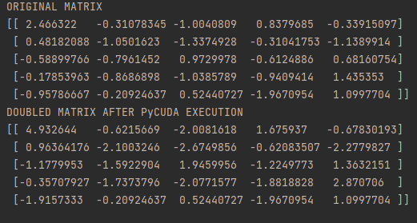
Matrix multiplication

Slide 8
Matrix multiplication
The preceding code starts with the following imports:
import pycuda.driver as cuda
import pycuda.autoinit
from pycuda.compiler import SourceModule
The import pycuda.autoinit statement automatically picks a GPU to run based on its availability and number. It also creates a GPU context for the subsequent code to run. If needed, both the chosen device and the created context are available from pycuda. autoinit as importable symbols, whereas the SourceModule component is the object where a C-like code for the GPU must be written.

Slide 9
Matrix multiplication
The first step is to generate the input 5×5 matrix. Since most GPU computations involve large arrays of data, the numpy module must be imported:
import numpy
a = numpy.random.randn(5,5)
Then, the items in the matrix are converted into a single precision mode, many NVIDIA cards
support only a single precision:
a = a.astype(numpy.float32)
The first operation that needs to be done in order to implement a GPU is to load the input array from the host memory (CPU) to the device (GPU). This is done at the beginning of the operation and consists of two steps that are performed by invoking the following two functions provided PyCUDA:
The memory allocation on the device is performed via the function cuda.mem_alloc. The device and host memory may not ever communicate while performing a function kernel. This means that, to run a function parallelly on the device, the data related to it must be present in the memory of the device itself. Before you copy data from the host memory to the device memory, you must allocate the memory required on the device: a_gpu = cuda.mem_alloc(a.nbytes).

Slide 10
Matrix multiplication
Copy the matrix from the host memory to that of the device with the following function:
call cuda.memcpy_htod : cuda.memcpy_htod(a_gpu, a).
Also note that a_gpu is one-dimensional and on the device, we need to handle it as such. All these operations do not require the invocation of a kernel and are made directly by the main processor. The SourceModule entity serves to define the (C-like) kernel function doubleMatrix that multiplies each array entry by 2:
mod = SourceModule("""
__global__ void doubleMatrix(float *a)
{
int idx = threadIdx.x + threadIdx.y*4;
a[idx] *= 2;
}
""")

Slide 11
Matrix multiplication
The __global__ qualifier directive indicates that the function doubleMatrix will be processed on the device. Only the CUDA nvcc compiler will perform this task.
Let's take a look at the function's body:
int idx = threadIdx.x + threadIdx.y*4;
The idx parameter is the matrix index identified by the thread coordinates threadIdx.x and threadIdx.y. Then, the element matrix with the index idx is multiplied by 2:
a[idx] *= 2;

Slide 12
Matrix multiplication
Note that this kernel function will be executed once in 16 different threads. Both the variables threadIdx.x and threadIdx.y contain indices between 0 and 3 and the pair is different for each thread. Threads scheduling is directly linked to the GPU architecture and its intrinsic parallelism. A block of threads is assigned to a single Streaming Multiprocessor (SM), and the threads are further divided into groups called warps. The size of a warp depends on the architecture under consideration. The threads of the same warp are managed by the control unit called the warp scheduler. To take full advantage of the inherent parallelism of SM, the threads of the same warp must execute the same instruction. If this condition does not occur, we speak of the divergence of threads. If the same warp threads execute different instructions, the control unit cannot handle all the warps. It must follow the sequences of instructions for every single thread (or for homogeneous subsets of threads) in a serial mode.
Let's observe how the thread block is divided into various warps, threads are divided by the value of threadIdx.
The threadIdx structure consists of three fields: threadIdx.x, threadIdx.y, and threadIdx.z.

Slide 13
Matrix multiplication

Slide 14
Matrix multiplication
We can see that the code in the kernel function will be automatically compiled by the nvcc CUDA compiler. If there are no errors, the pointer of this compiled function will be created. In fact, mod.get_function("doubleMatrix") returns an identifier to the func function that we created:
func = mod.get_function("doubleMatrix ")
To perform a function on the device, you must first configure the execution appropriately. This means that you need to determine the size of the coordinates to identify and distinguish the thread belonging to different blocks. This will be done using the block parameter inside the func call:
func(a_gpu, block = (5, 5, 1))

Slide 15
Matrix multiplication
The block = (5, 5, 1) function tells us that we are calling a kernel function with the a_gpu linearized input matrix and a single thread block of the size 5 threads in the x direction, 5 threads in the y direction, and 1 thread in the z direction, 16 threads in total.
This structure is designed with the parallel implementation of the algorithm in mind. The division of the workload results in an early form of parallelism that is sufficient and necessary to make use of the computing resources provided by the GPU. Once you've configured the kernel's invocation, you can invoke the kernel function that executes instructions parallelly on the device. Each thread executes the same code kernel.
After the computation in the GPU device, we use an array to store the results:
a_doubled = numpy.empty_like(a)
cuda.memcpy_dtoh(a_doubled, a_gpu)
This will be printed as follows:
print (a)
print (a_doubled)

